Slide 1

Twitter’s Dilemma
#ElonMuskBuysTwitter
A sentiment analysis on Elon Musk’s buyout of the social media company.
Josh Wang, Metis, 2022/05/18

Slide 2
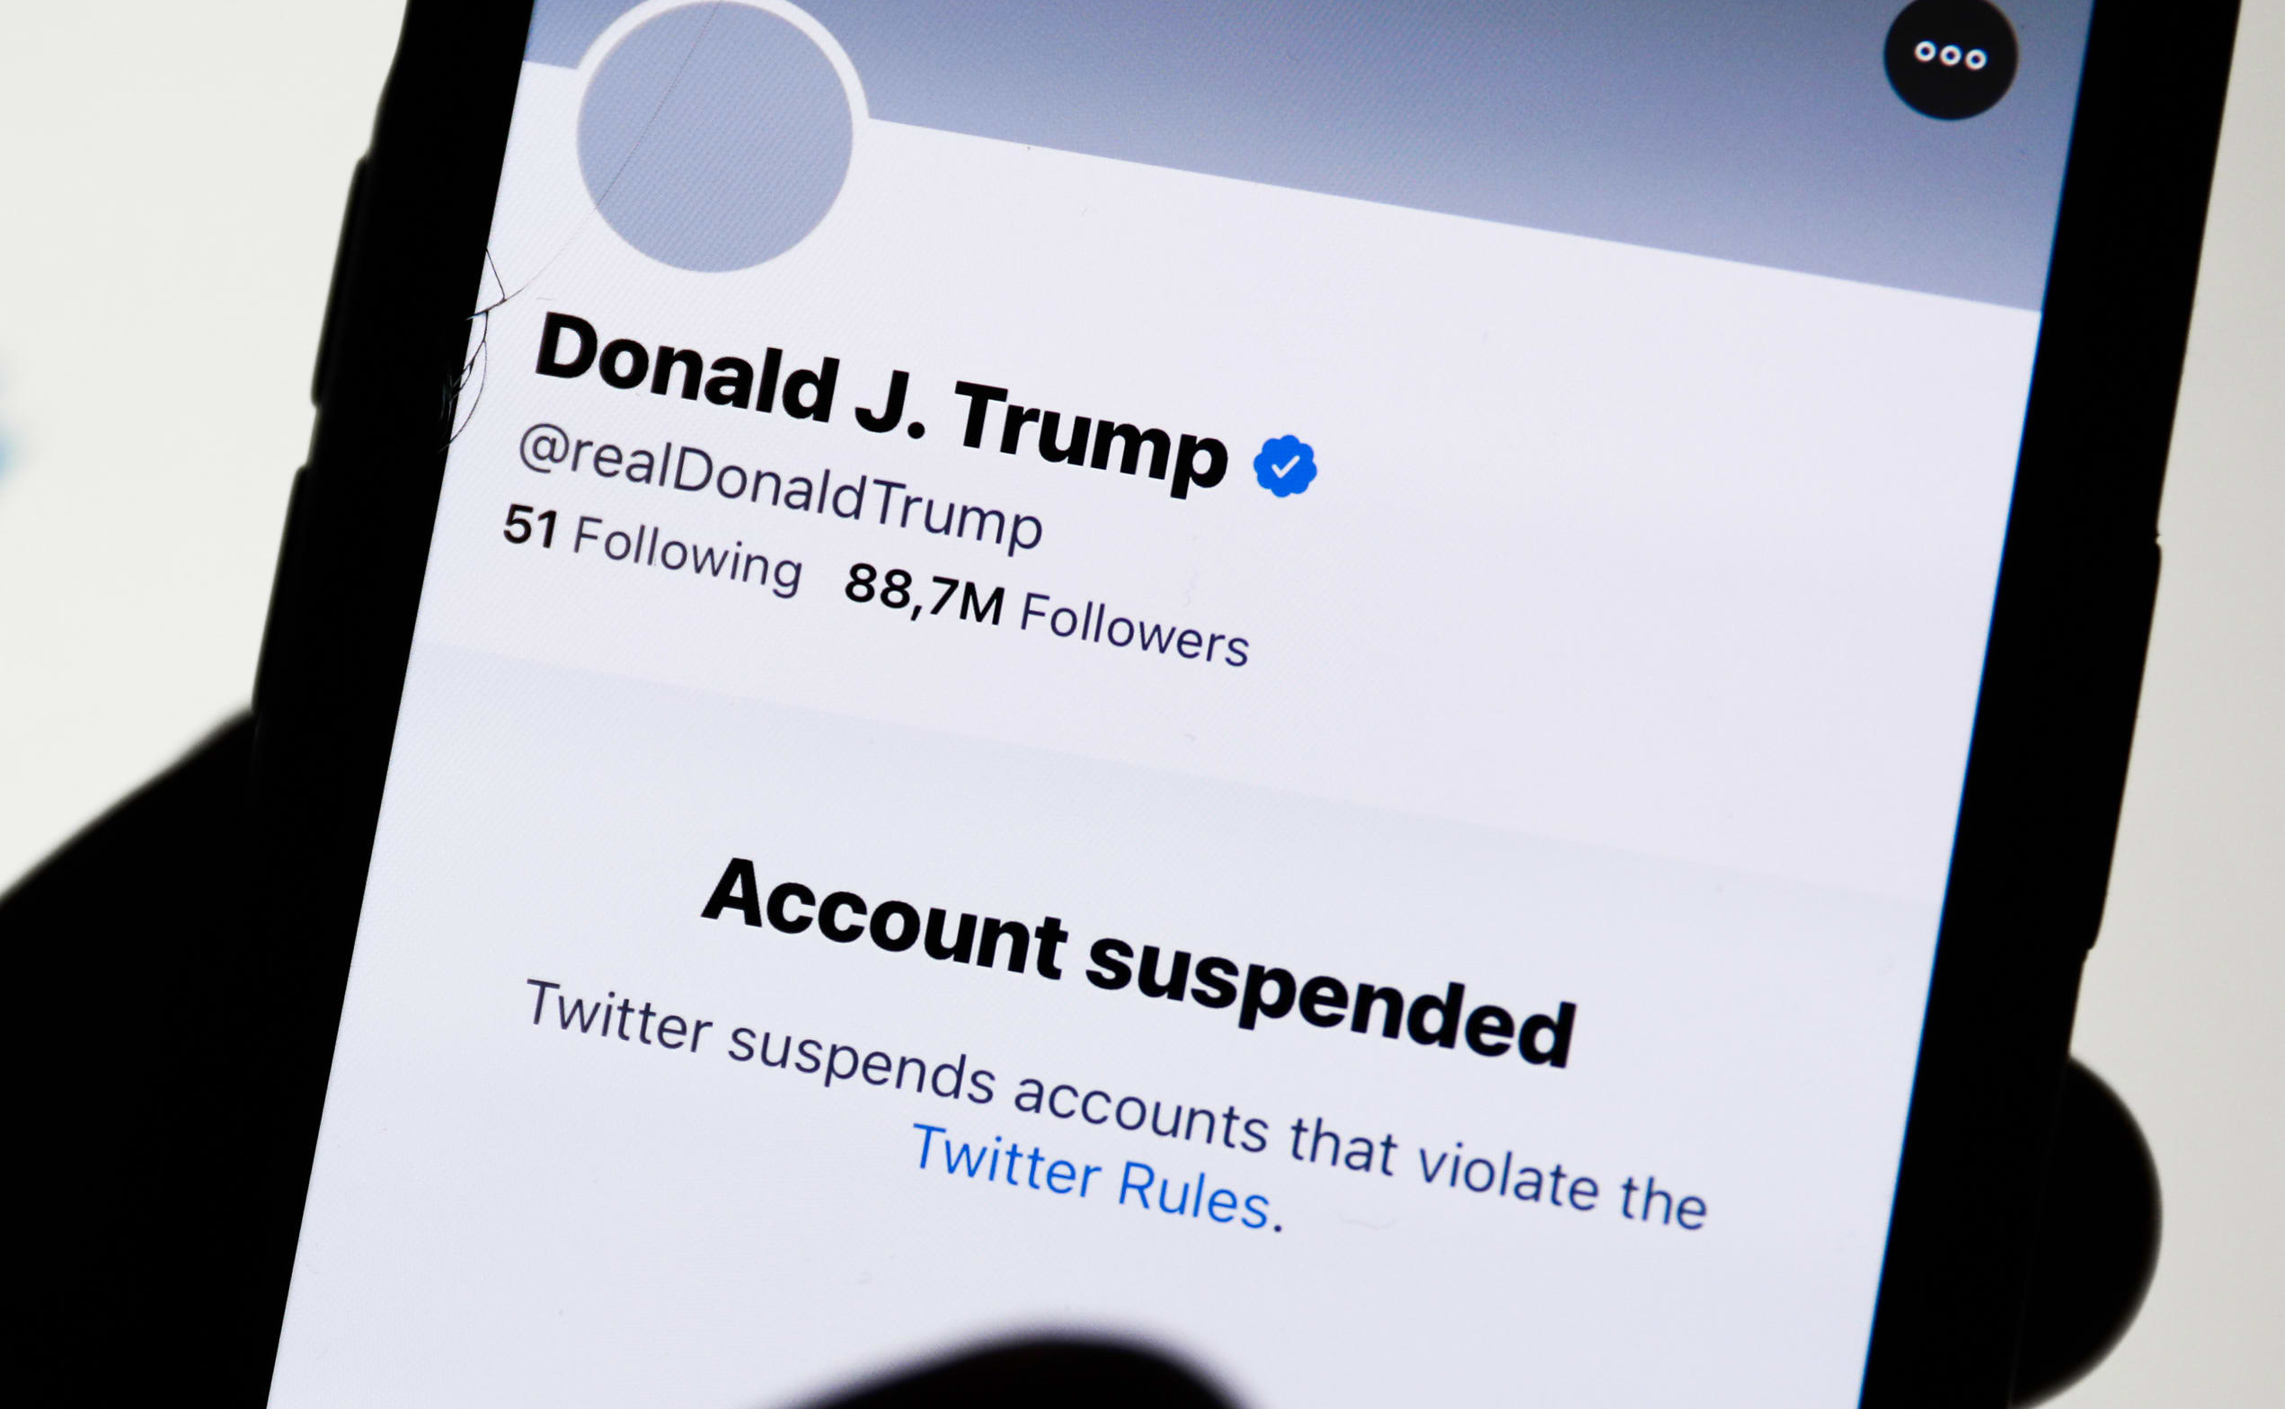
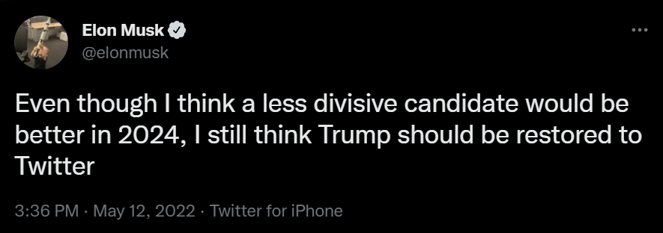
Background
Twitter has long been seen as a left-leaning platform
Elon Musk is a politically-incorrect libertarian entrepreneur

Slide 3
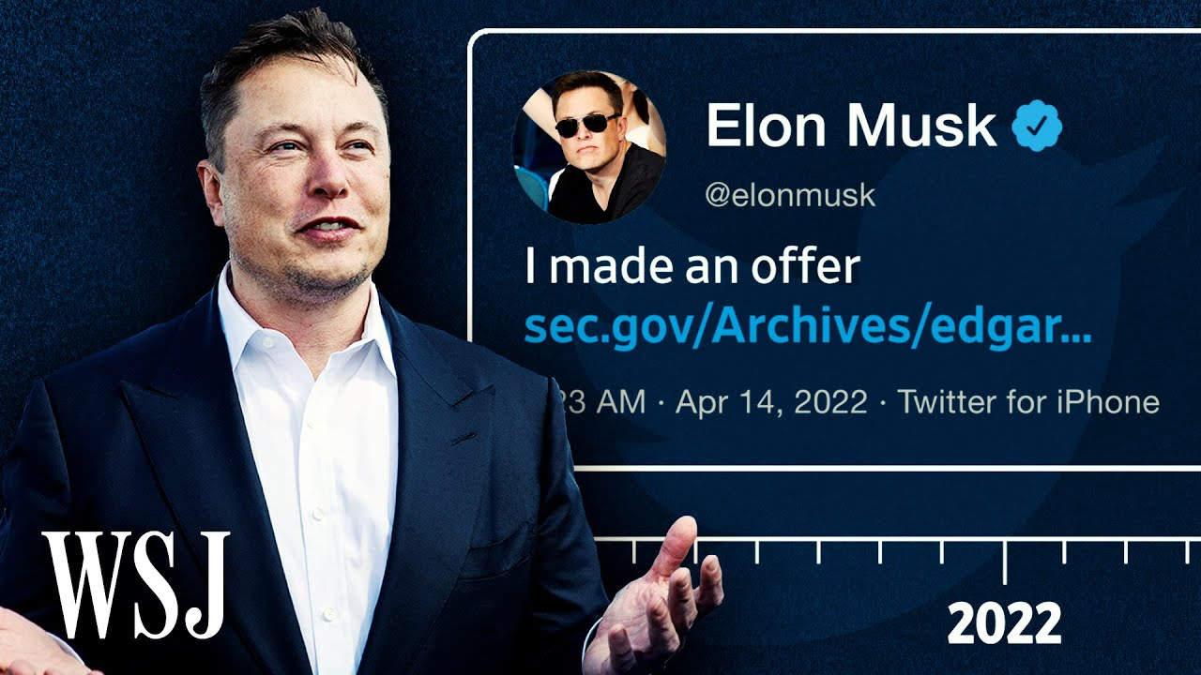
Background
As the new face of Twitter, Elon’s public image affects the fate of the company.
It is important to understand the public reception of Elon’s Twitter buyout.

Slide 4
The Data
May 10, 2022
Data came from tweets from Twitter users based on keywords/hashtags related to Elon Musk and his Twitter deal
Apr 5, 2021
Apr 14, 2022
Apr 25, 2022
Relatively uneventful time point as the control.
Elon first announced his offer.
Elon’s deal was accepted by Twitter.
Elon tweets that he would unban Trump.

Slide 5




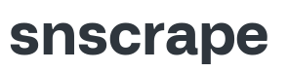




Methodology
Scraping tweets
Vectorizing
Topic Modeling
TF-IDF
NMF, LSA, LDA
Cleaning
Preprocessing
Visualization
40k tweets in total
Labeled users’ political stance based on key phrases in their profile description
Filtered for English tweets, removed stop words, punctuations, lemmatized
Sentiment Analysis
VADER
App Deployment

Slide 6
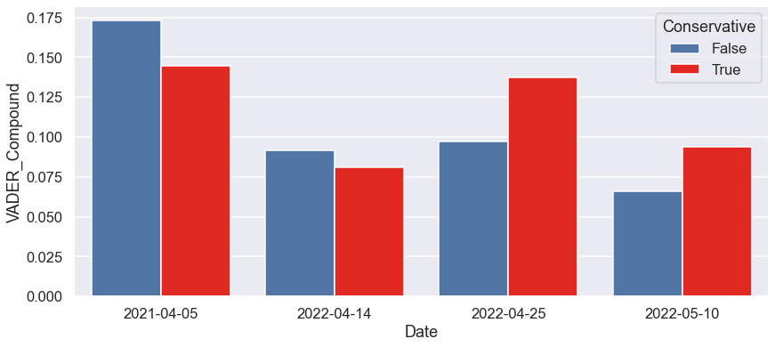
Twitter Sentiment towards Elon over time
Control
Offer announced
Offer accepted
Suggests lifting Trump ban

Slide 7
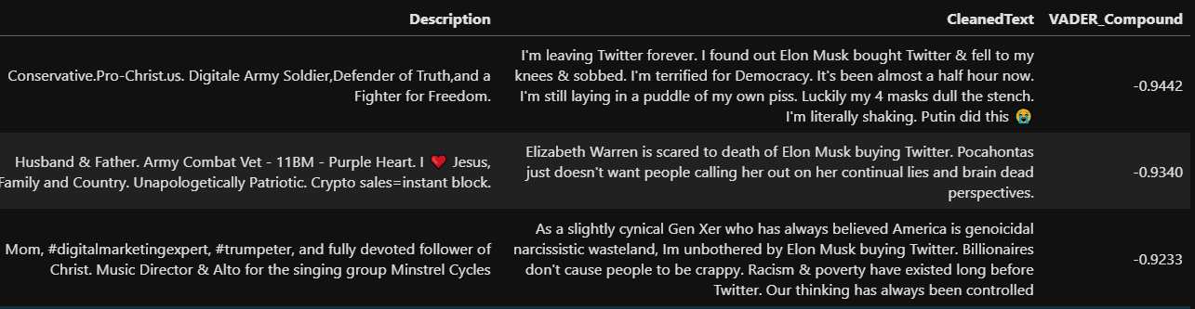
Twitter Sentiment towards Elon over time
Control
Offer announced
Offer accepted
Suggests lifting Trump ban
Negative tweets of conservatives are mostly sarcastic or antagonistic towards the other side.

Slide 8
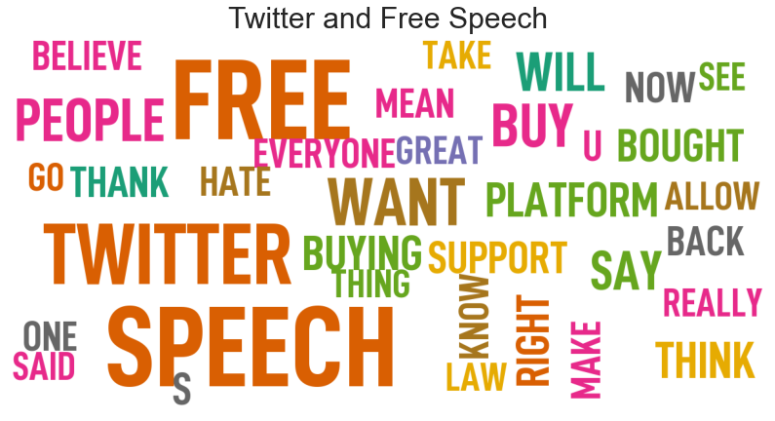
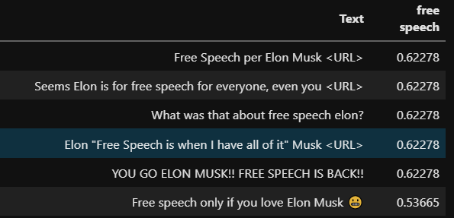
Topic modeling by Latent Semantic Analysis

Slide 9
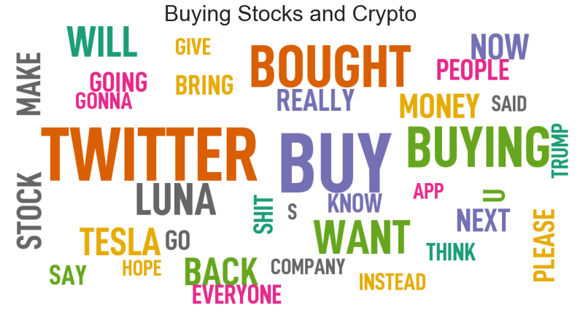
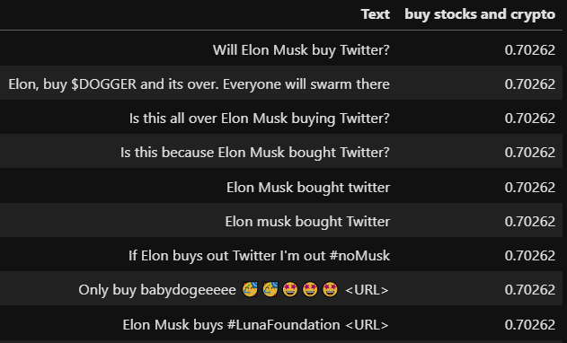
Topic modeling by Latent Semantic Analysis

Slide 10
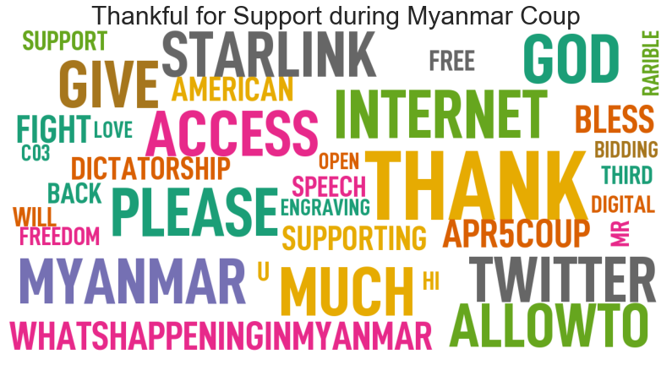
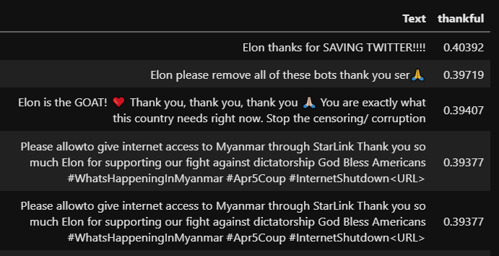
Topic modeling by Latent Semantic Analysis

Slide 11
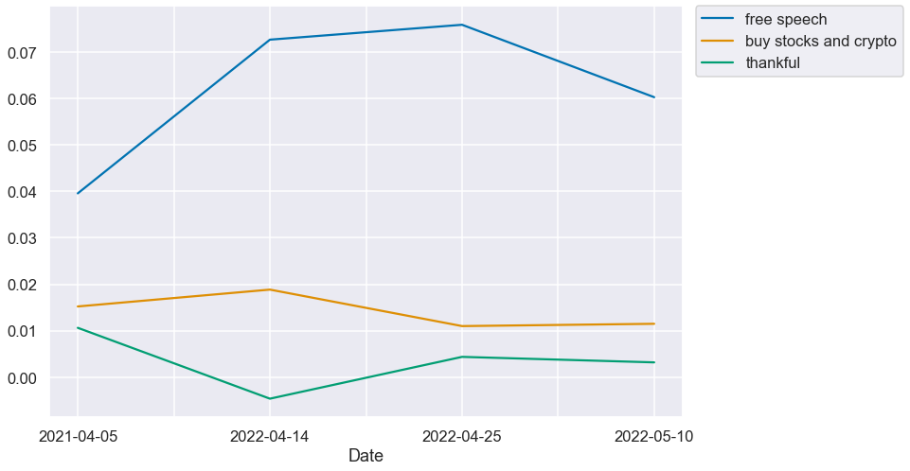
Topics over time

Slide 12
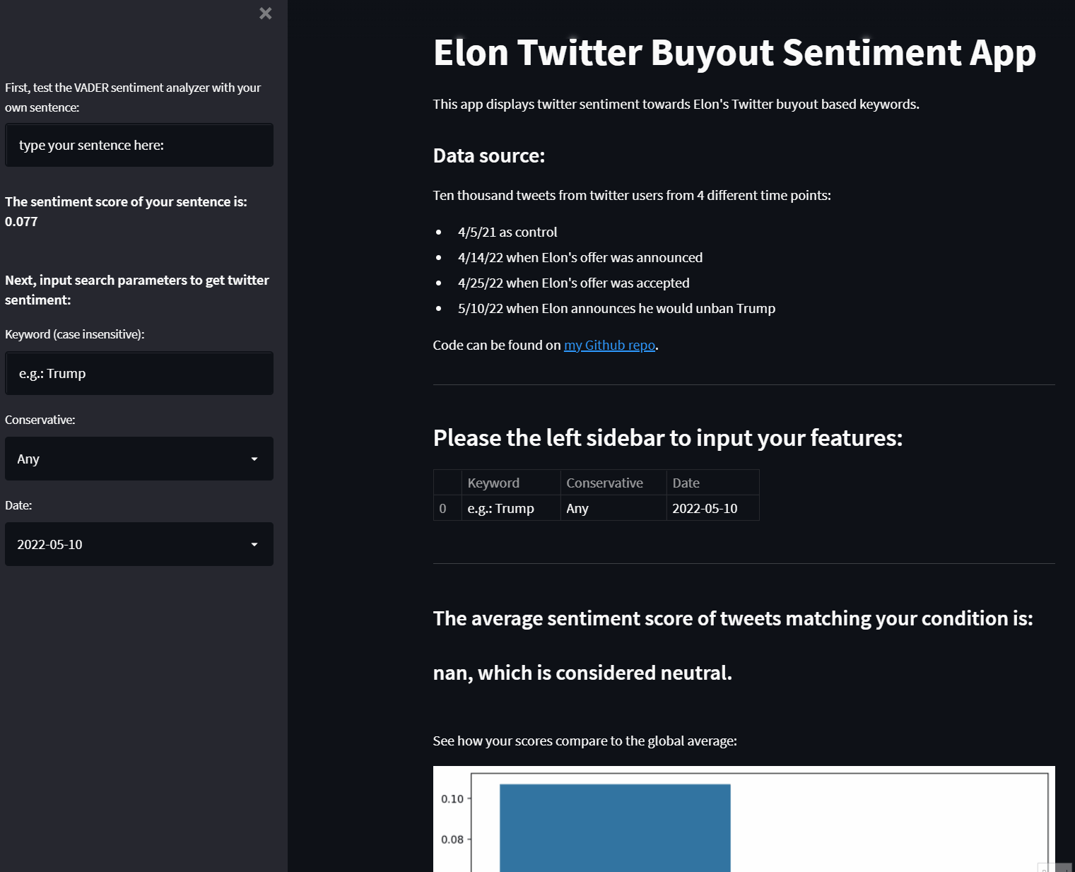
Streamlit Deployment
Sentiment analysis app:
Input: keyword, political_stance, date
Output: average sentiment of tweets matching the criteria

Slide 13
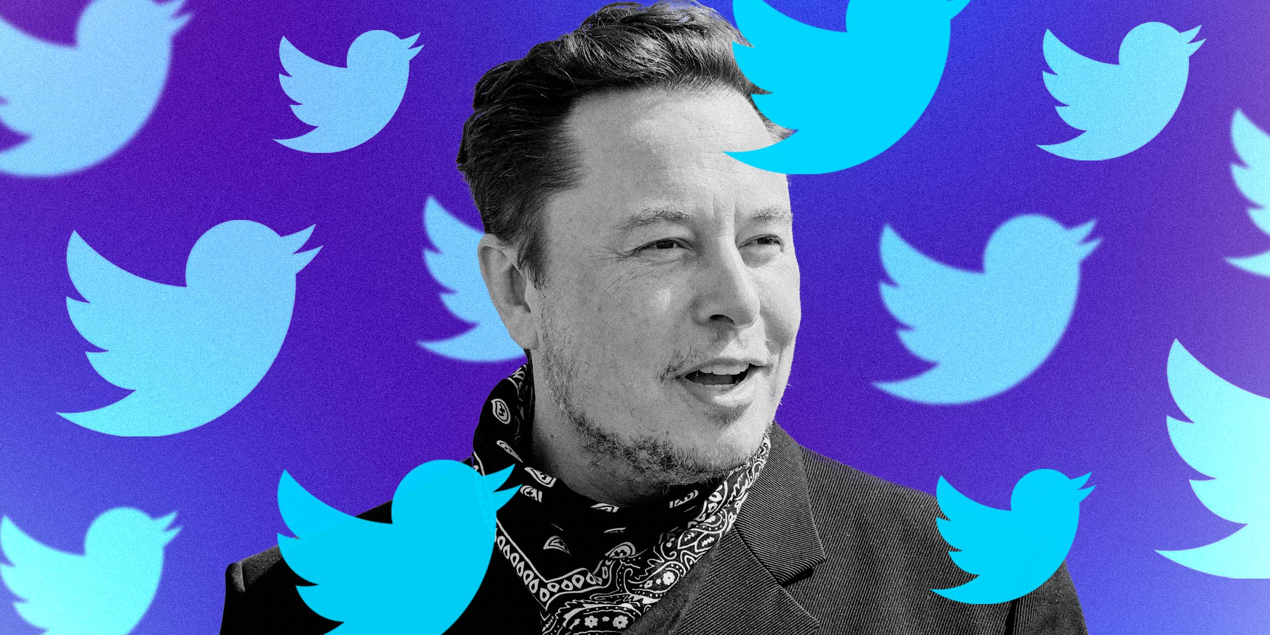
Thank you.
The code used for this project can be found here:
https://github.com/JoshJingtianWang/ElonMusk_NLP

Slide 14
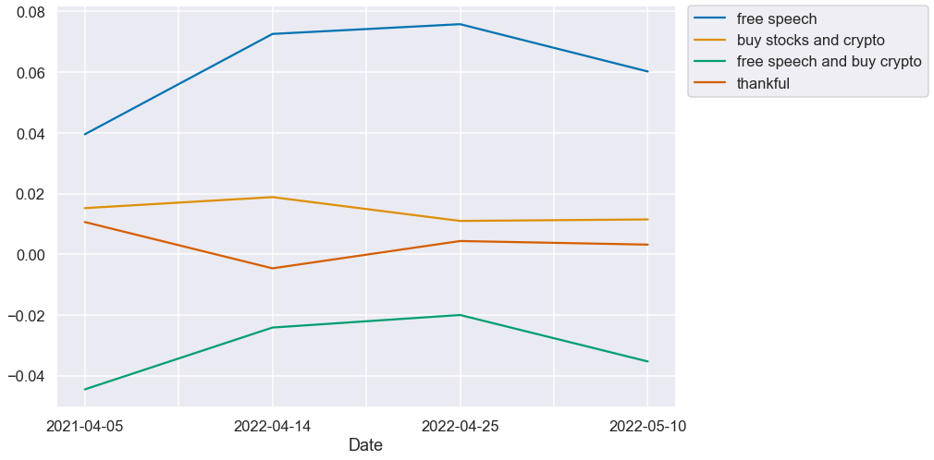
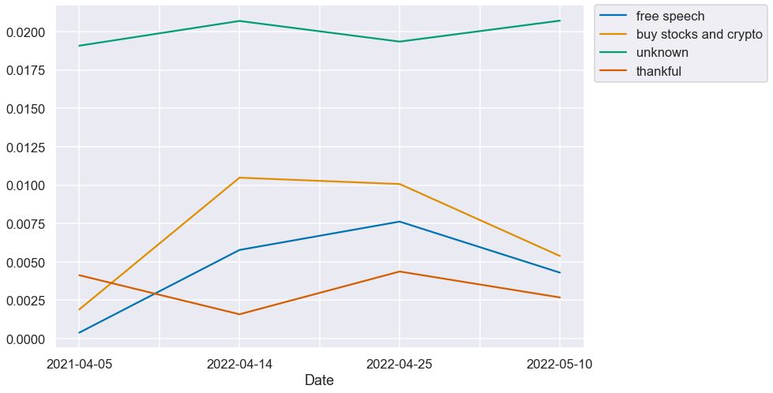
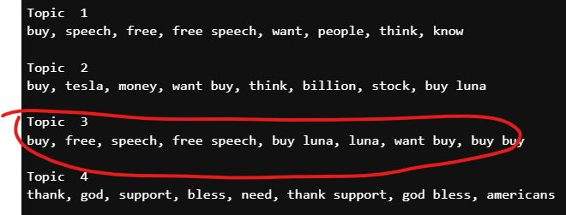
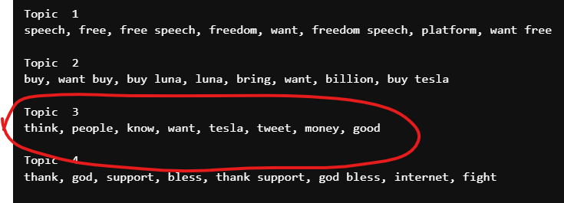
LSA and NMF

